Slide 1
SChwarzkopf Elementary PTA
General Meeting
Shine Together!
SEPTEMBER 21ST, 2023
5:00PM - 6:00PM

Slide 2
The team
BEAR BASH
Kyle Mobley
BEAR RUN
Jeff Grim
BOX TOPS
Nikki Marshall
REFLECTIONS
Jenny Mun
HOLIDAY SHOP
Jessica Tessi
YEARBOOK
Meribeth Weber &
Holly Menendez
PAPA BEAR
Domenic Colangelo
JUNIOR ACHIEVEMENT
Meghan McGuinness

Slide 3
Schwarzkopf PTA Budget

Slide 4
Year at a Glance

Slide 5
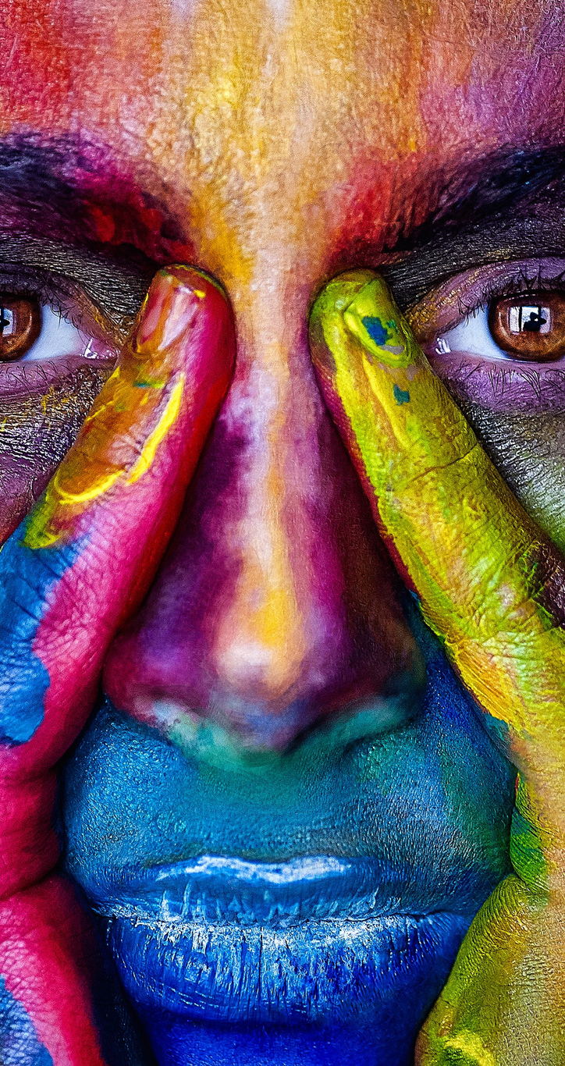
Reflections Art Contest

Slide 6
Meet the Principal
Pamela Wilkins

Slide 7
Thank you Sponsors!
Family Sponsors
The Medina Family
The Hernandez Family
The Colangelo Family
The Grim Family
The Meza Family
The Robinson Family
The Metcalf Family
The McGuinness Family
The Kinney Family
The Slobozhaninov Family
The Pham Family
The Andrade Family
The Purcell Family
To become a Sponsor please visit www.schwarzkopfpta.org

Slide 8
THANK YOU
Follow us on Social Media!
To become a Schwarzkopf PTA Member
Visit www.schwarzkopfpta.org
Questions? ptaschwarzkopf@gmail.com

Slide 9
BINGO
TIME

